Slide 1
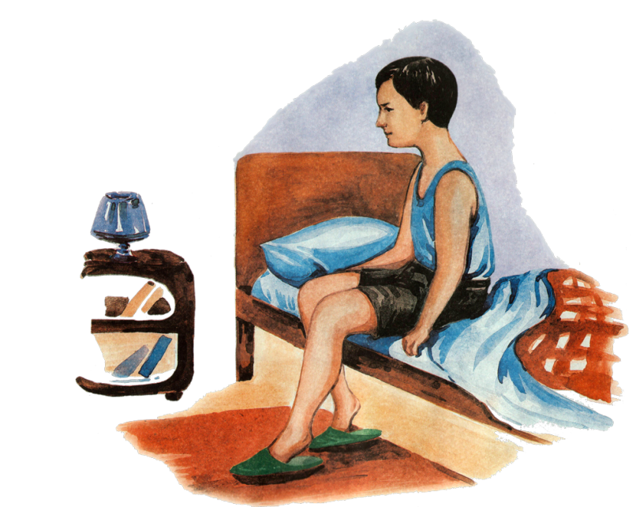
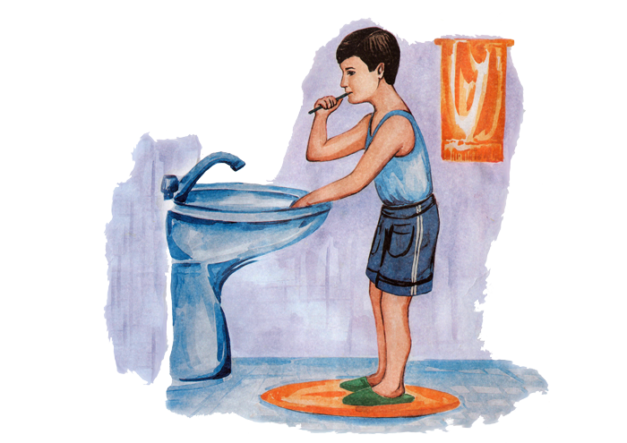
Present Perfect
The Present Perfect is used to indicate a link between the present and the past. The time of the action is before now but not specified, and we are often more interested in the result than in the action itself.
Merdan has got up.
Now he is brushing
his teeth.

Slide 2
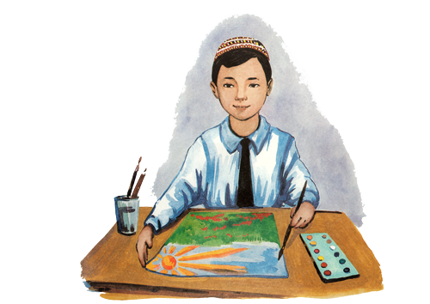

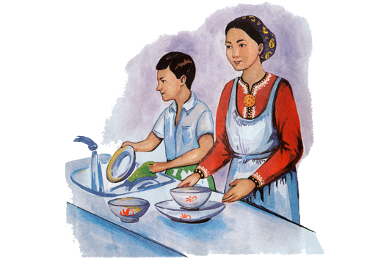
Formula of making up sentences in Present Perfect Tense.
Subject
Verb3
+
noun
+
have/has
+
have
drawn
a picture.
I
Mike
has
read
a book.
They
have
washed
dishes.

Slide 3
The present perfect is used to describe:
1.An action or situation that started in the past and continues in the present.
We
have
lived
in Kerki since 1982.
2. An action performed during a period that has not yet finished.
He
has
been
in Kerki twice in this month.
3.A repeated action in an unspecified period between the past and now.
I
have
driven
many cars in Kerki.

Slide 4
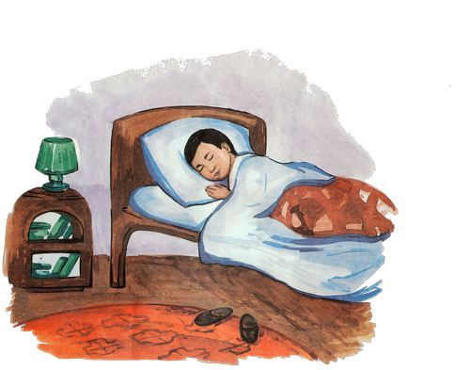

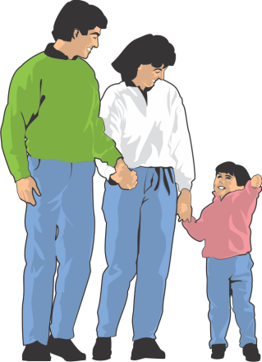
The present perfect is used to describe:
4. An action that was completed in the very recent past.
Merdan
has
just slept.
5.An action when the time is not important.
They
have
built
their home.

